Slide 1
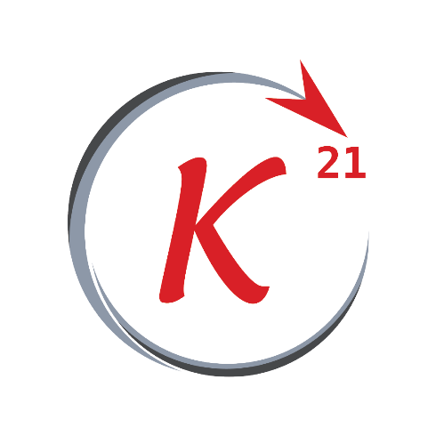
Normal Equation

Slide 2
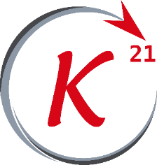

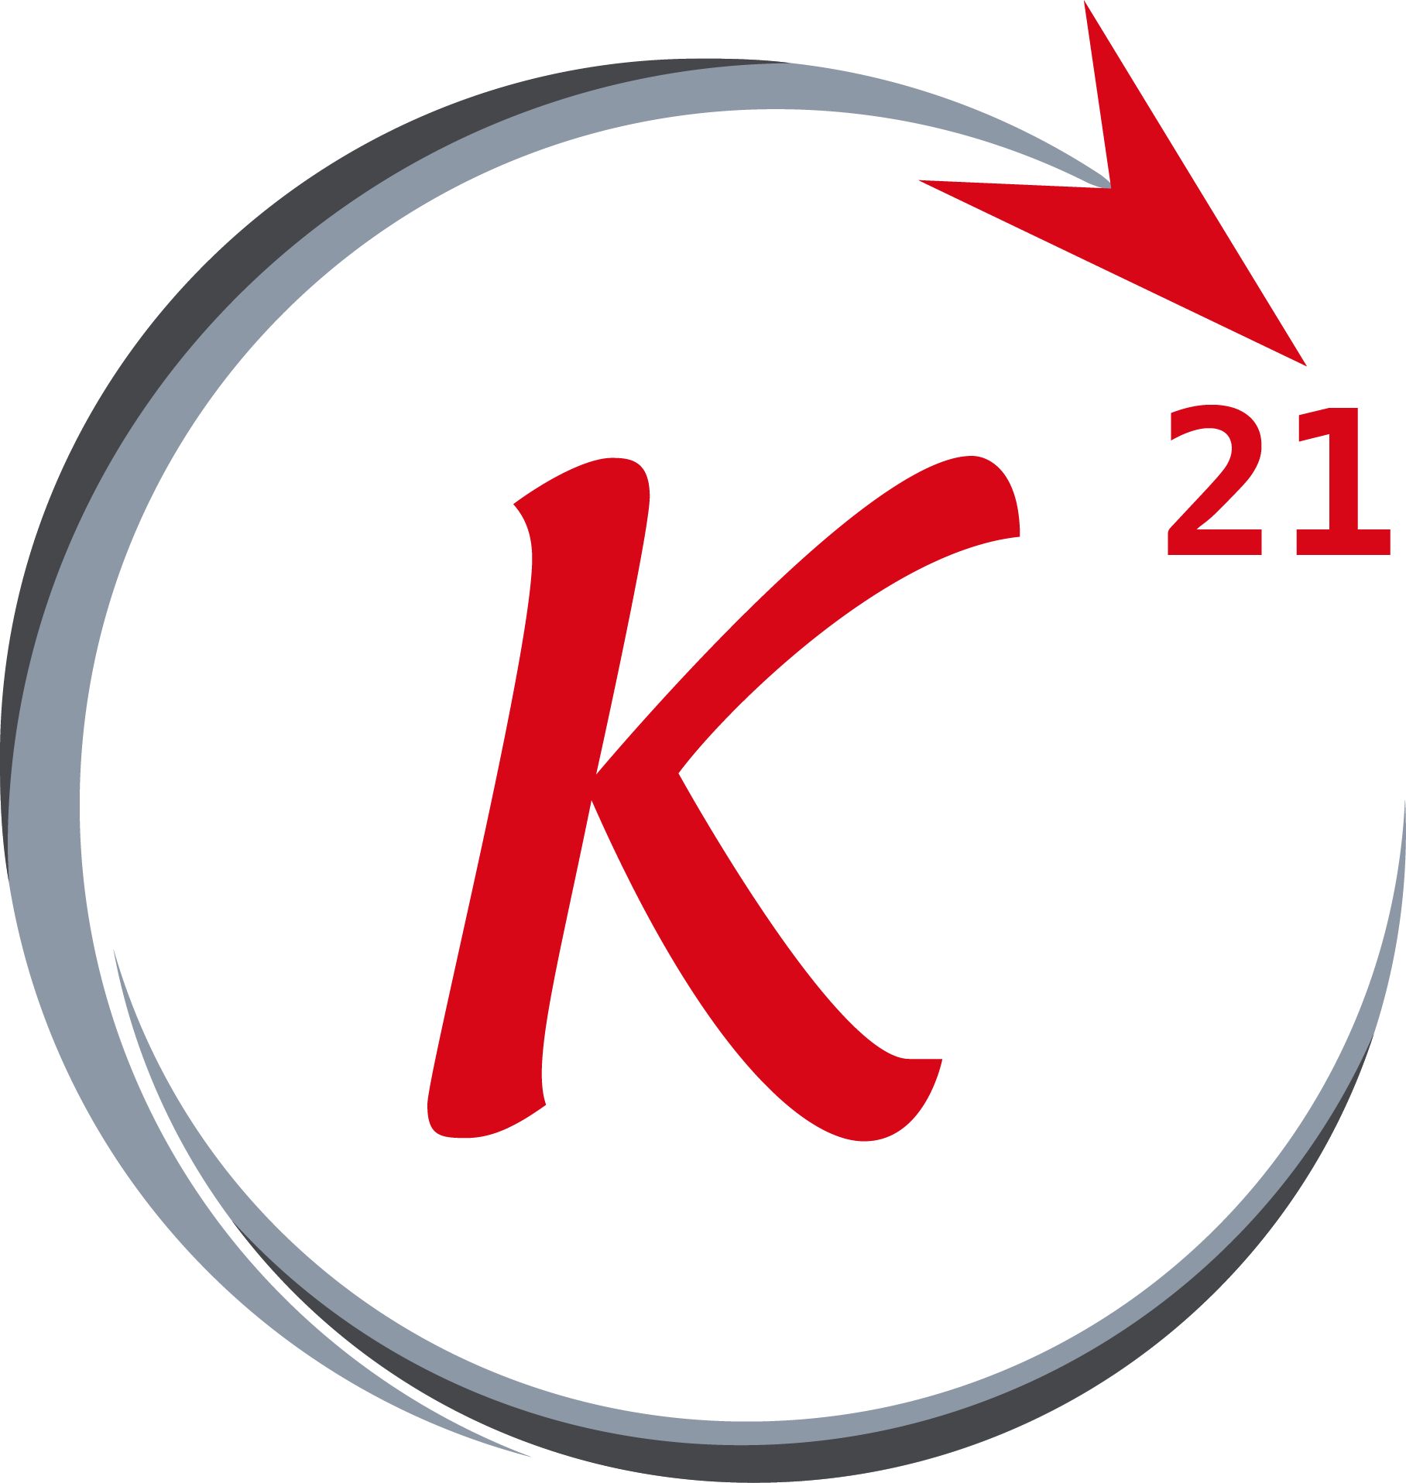


Normal equation
Formula
Grow Through

Slide 3
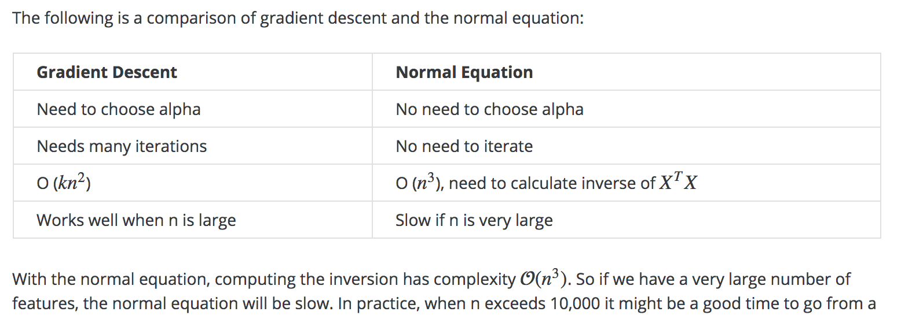
Normal equation
vs GD
Grow Through

Slide 4
Over Fitting & Regularization

Slide 5
OF & Regularization
Outline
- Underfitting
- Overfitting
- Regularization
Grow Through

Slide 6
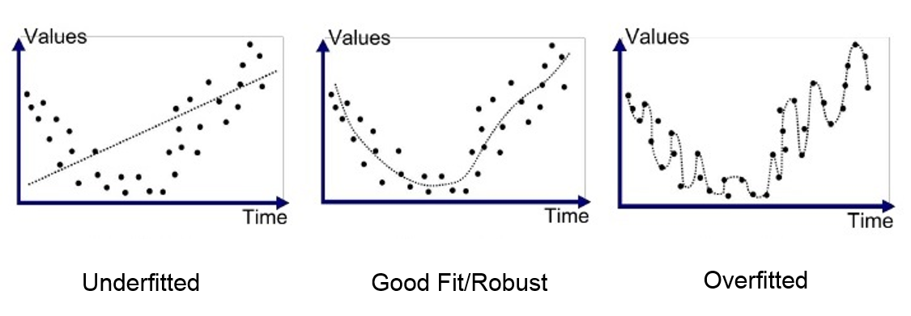
Underfitting
A statistical model or a machine learning algorithm is said to have underfitting when it cannot capture the underlying trend of the data.
It is also called a high bias problem.
An example of an underfitting problem.
Grow Through

Slide 7
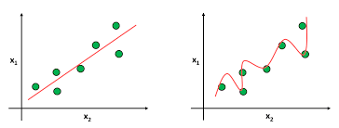
Overfitting
Overfitting happens when a model learns the detail and noise in the training data to the extent that it negatively impacts the performance of the model on new data. This means that the noise or random fluctuations in the training data is picked up and learned as concepts by the model.
The model in this case fits the training
data so well but fails fitting the testing data.
Grow Through

Slide 8
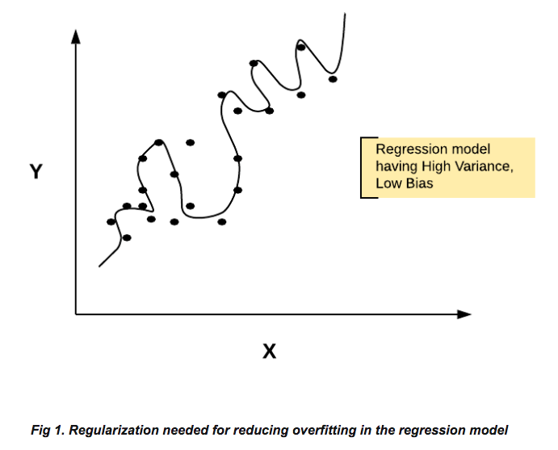
Overfitting
An overfitted model
is so called to have
high variance.
In such a model , a linear fit would perform finer than the fit shown in the graph using high order polynomial terms with such a noise or variance in the training set generates a high variance overfitted model.
Grow Through

Slide 9
Fitting
Overfitting: Good performance on the training data, poor generliazation to other data.
Underfitting: Poor performance on the training data and poor generalization to other data
Grow Through

Slide 10
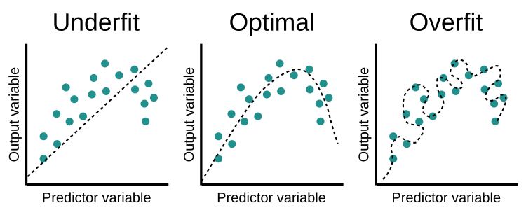
Optimal model
In the example shown below, a linear regression model might underfit the data and a higher order model might get severely affected by the noise and variance in the dataset, an optimal fit would be in between.
Grow Through

Slide 11
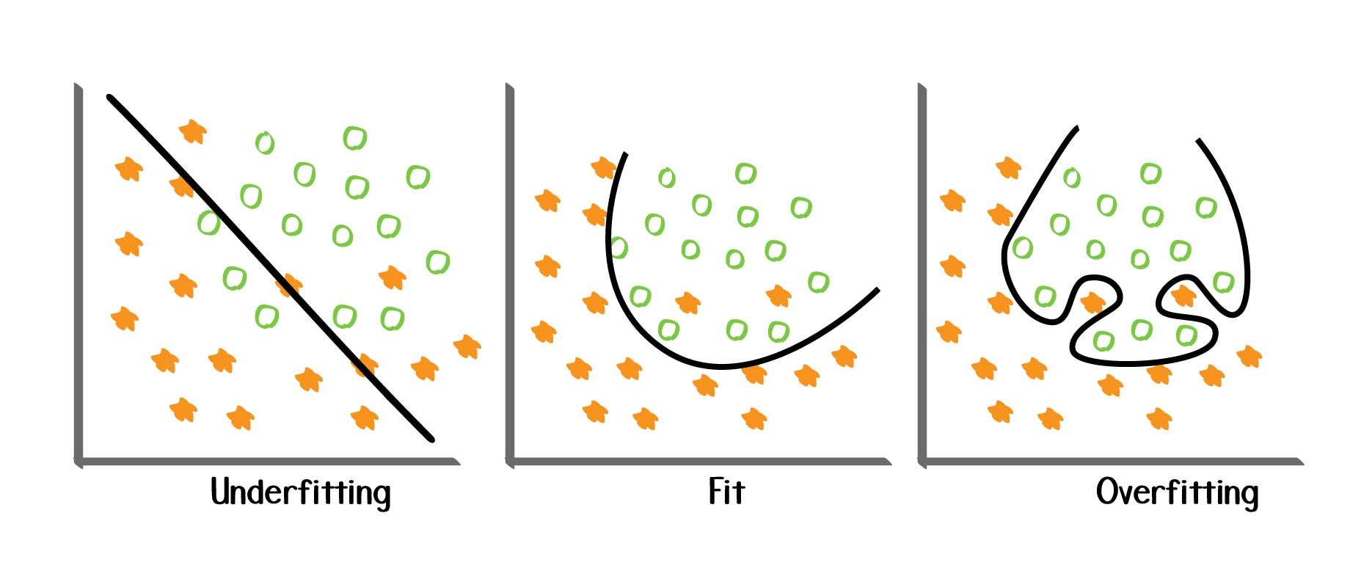
Optimal model
The same applies to logistic regression.
Grow Through

Slide 12
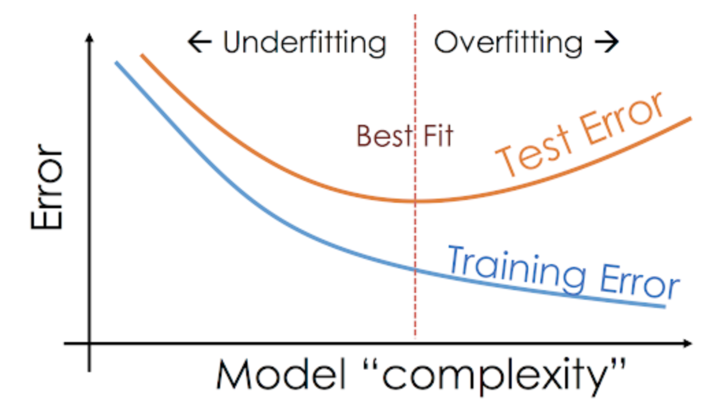
Optimal model
Model complexity
vs
Test & Training Errors.
Grow Through

Slide 13
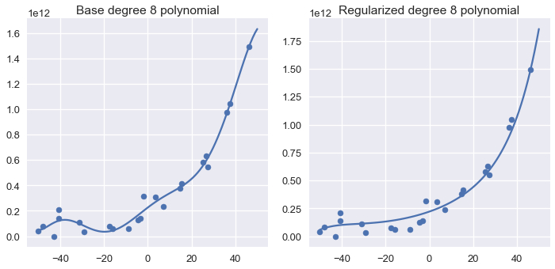
Regularization
Regularization is a technique used to reduce the error (testing error) by fitting a function appropriately on the given training set and avoid overfitting.
Grow Through

Slide 14
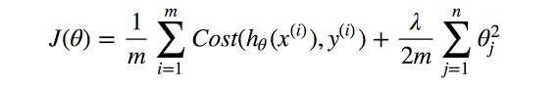
Regularization
In regularization, a simple term added in the cost function whether it was a linear regression or a logistic regression, it helps minimizing the values of the parameters while minimizing the error value, thus penalizing the parameters that try to fit the model as neatly as possible and reduce the overfitting problem.
Grow Through

Slide 15
Goodbye

